Slide 1
Lecture 02 Divide and Conquer (Mergesort)
CSE373: Design and Analysis of Algorithms

Slide 2
Divide and Conquer
Recursive in structure
Divide the problem into independent sub-problems that are similar to the original but smaller in size
Conquer the sub-problems by solving them recursively. If they are small enough, just solve them in a straightforward manner.
Combine the solutions to create a solution to the original problem

Slide 3
Example: Merge Sort
Sorting Problem: Sort a sequence of n elements into non-decreasing order.
Divide: Divide the n-element sequence to be sorted into two subsequences of n/2 elements each
Conquer: Sort the two subsequences recursively using merge sort.
Combine: Merge the two sorted subsequences to produce the sorted answer.

Slide 4
Merging two sorted subsequences
6 | 18 | 56 | 62 | 1 | 9 | 15 | 43

Slide 5
Merging two sorted subsequences
Unsorted
6 | 18 | 56 | 62 | 1 | 9 | 15 | 43
Sorted
Sorted

Slide 6
Merging two sorted subsequences
6 | 18 | 56 | 62 | 1 | 9 | 15 | 43
Merging

Slide 7
Merging two sorted subsequences
6 | 18 | 56 | 62 | 1 | 9 | 15 | 43
Merging
Left half
Right half
Minimum between first elements in both halves

Slide 8
Merging two sorted subsequences
6 | 18 | 56 | 62 | 1 | 9 | 15 | 43
Merging
1
Left half
Right half
Minimum between first elements in both halves

Slide 9
Merging two sorted subsequences
6 | 18 | 56 | 62 | 1 | 9 | 15 | 43
Merging
1
Left half
Right half
Minimum between first elements in both halves

Slide 10
Merging two sorted subsequences
6 | 18 | 56 | 62 | 1 | 9 | 15 | 43
Merging
1 | 6
Left half
Right half
Minimum between first elements in both halves

Slide 11
Merging two sorted subsequences
6 | 18 | 56 | 62 | 1 | 9 | 15 | 43
Merging
1 | 6
Left half
Right half
Minimum between first elements in both halves

Slide 12
Merging two sorted subsequences
6 | 18 | 56 | 62 | 1 | 9 | 15 | 43
Merging
1 | 6 | 9
Left half
Right half
Minimum between first elements in both halves

Slide 13
Merging two sorted subsequences
6 | 18 | 56 | 62 | 1 | 9 | 15 | 43
Merging
1 | 6 | 9
Left half
Right half
Minimum between first elements in both halves

Slide 14
Merging two sorted subsequences
6 | 18 | 56 | 62 | 1 | 9 | 15 | 43
Merging
1 | 6 | 9 | 15
Left half
Right half
Minimum between first elements in both halves

Slide 15
Merging two sorted subsequences
6 | 18 | 56 | 62 | 1 | 9 | 15 | 43
Merging
1 | 6 | 9 | 15
Left half
Right half
Minimum between first elements in both halves

Slide 16
Merging two sorted subsequences
6 | 18 | 56 | 62 | 1 | 9 | 15 | 43
Merging
1 | 6 | 9 | 15 | 18
Left half
Right half
Minimum between first elements in both halves

Slide 17
Merging two sorted subsequences
6 | 18 | 56 | 62 | 1 | 9 | 15 | 43
Merging
1 | 6 | 9 | 15 | 18
Left half
Right half
Minimum between first elements in both halves

Slide 18
Merging two sorted subsequences
6 | 18 | 56 | 62 | 1 | 9 | 15 | 43
Merging
1 | 6 | 9 | 15 | 18 | 43
Left half
Right half
Minimum between first elements in both halves

Slide 19
Merging two sorted subsequences
6 | 18 | 56 | 62 | 1 | 9 | 15 | 43
Merging
1 | 6 | 9 | 15 | 18 | 43
Left half
Right half
Minimum between first elements in both halves

Slide 20
Merging two sorted subsequences
6 | 18 | 56 | 62 | 1 | 9 | 15 | 43
Merging
1 | 6 | 9 | 15 | 18 | 43 | 56 | 62
Left half
Right half
Minimum between first elements in both halves

Slide 21
Merging two sorted subsequences
1 | 6 | 9 | 15 | 18 | 43 | 56 | 62
Merging
1 | 6 | 9 | 15 | 18 | 43 | 56 | 62
Left half
Right half
Minimum between first elements in both halves

Slide 22
Merging two sorted subsequences
1 | 6 | 9 | 15 | 18 | 43 | 56 | 62

Slide 23
Merging two sorted subsequences
Merge(A, p, q, r)
1 n₁ ← q – p + 1
2 n₂ ← r – q
for i ← 1 to n₁
do L[i] ← A[p + i – 1]
for j ← 1 to n₂
do R[j] ← A[q + j]
L[n₁+1] ← ∞
R[n₂+1] ← ∞
i ← 1
j ← 1
for k ←p to r
do if L[i] ≤ R[j]
then A[k] ← L[i]
i ← i + 1
else A[k] ← R[j]
j ← j + 1
Input: Array containing sorted subarrays A[p..q] and A[q+1..r].
Output: Merged sorted subarray in A[p..r].
Sentinels, to avoid having to
check if either subarray is
fully copied at each step.

Slide 24
Time complexity of Merge
Merge(A, p, q, r) //Let r-p+1 = n
1 n₁ ← q – p + 1 //Θ(1)
2 n₂ ← r – q //Θ(1)
for i ← 1 to n₁ //Θ(q-p+1)
do L[i] ← A[p + i – 1]
for j ← 1 to n₂ //Θ(r-q)
do R[j] ← A[q + j]
L[n₁+1] ← ∞
R[n₂+1] ← ∞
i ← 1
j ← 1
for k ←p to r //Θ(r-p+1) = Θ(n)
do if L[i] ≤ R[j]
then A[k] ← L[i]
i ← i + 1
else A[k] ← R[j]
j ← j + 1
//Total time: Θ(n)
Input: Array containing sorted subarrays A[p..q] and A[q+1..r].
Output: Merged sorted subarray in A[p..r].

Slide 25
Merge Sort
0 | 1 | 2 | 3 | 4 | 5 | 6 | 7 | 8 | 9 | 10 | 11 | 12 | 13 | 14 | 15
18 | 26 | 32 | 6 | 43 | 15 | 9 | 1 | 22 | 26 | 19 | 55 | 37 | 43 | 99 | 2

Slide 26
Merge Sort
0 | 1 | 2 | 3 | 4 | 5 | 6 | 7 | 8 | 9 | 10 | 11 | 12 | 13 | 14 | 15
18 | 26 | 32 | 6 | 43 | 15 | 9 | 1 | 22 | 26 | 19 | 55 | 37 | 43 | 99 | 2
18 | 26 | 32 | 6 | 43 | 15 | 9 | 1 | 22 | 26 | 19 | 55 | 37 | 43 | 99 | 2

Slide 27
Merge Sort
0 | 1 | 2 | 3 | 4 | 5 | 6 | 7 | 8 | 9 | 10 | 11 | 12 | 13 | 14 | 15
18 | 26 | 32 | 6 | 43 | 15 | 9 | 1 | 22 | 26 | 19 | 55 | 37 | 43 | 99 | 2
18 | 26 | 32 | 6 | 43 | 15 | 9 | 1 | 22 | 26 | 19 | 55 | 37 | 43 | 99 | 2
18 | 26 | 32 | 6 | 43 | 15 | 9 | 1 | 22 | 26 | 19 | 55 | 37 | 43 | 99 | 2

Slide 28
Merge Sort
0 | 1 | 2 | 3 | 4 | 5 | 6 | 7 | 8 | 9 | 10 | 11 | 12 | 13 | 14 | 15
18 | 26 | 32 | 6 | 43 | 15 | 9 | 1 | 22 | 26 | 19 | 55 | 37 | 43 | 99 | 2
18 | 26 | 32 | 6 | 43 | 15 | 9 | 1 | 22 | 26 | 19 | 55 | 37 | 43 | 99 | 2
18 | 26 | 32 | 6 | 43 | 15 | 9 | 1 | 22 | 26 | 19 | 55 | 37 | 43 | 99 | 2
18 | 26 | 32 | 6 | 43 | 15 | 9 | 1 | 22 | 26 | 19 | 55 | 37 | 43 | 99 | 2

Slide 29
Merge Sort
0 | 1 | 2 | 3 | 4 | 5 | 6 | 7 | 8 | 9 | 10 | 11 | 12 | 13 | 14 | 15
18 | 26 | 32 | 6 | 43 | 15 | 9 | 1 | 22 | 26 | 19 | 55 | 37 | 43 | 99 | 2
18 | 26 | 32 | 6 | 43 | 15 | 9 | 1 | 22 | 26 | 19 | 55 | 37 | 43 | 99 | 2
18 | 26 | 32 | 6 | 43 | 15 | 9 | 1 | 22 | 26 | 19 | 55 | 37 | 43 | 99 | 2
18 | 26 | 32 | 6 | 43 | 15 | 9 | 1 | 22 | 26 | 19 | 55 | 37 | 43 | 99 | 2
18 | 26 | 32 | 6 | 43 | 15 | 9 | 1 | 22 | 26 | 19 | 55 | 37 | 43 | 99 | 2

Slide 30
Merge Sort
0 | 1 | 2 | 3 | 4 | 5 | 6 | 7 | 8 | 9 | 10 | 11 | 12 | 13 | 14 | 15
18 | 26 | 32 | 6 | 43 | 15 | 9 | 1 | 22 | 26 | 19 | 55 | 37 | 43 | 99 | 2
18 | 26 | 32 | 6 | 43 | 15 | 9 | 1 | 22 | 26 | 19 | 55 | 37 | 43 | 99 | 2
18 | 26 | 32 | 6 | 43 | 15 | 9 | 1 | 22 | 26 | 19 | 55 | 37 | 43 | 99 | 2
18 | 26 | 32 | 6 | 43 | 15 | 9 | 1 | 22 | 26 | 19 | 55 | 37 | 43 | 99 | 2
18 | 26 | 32 | 6 | 43 | 15 | 9 | 1 | 22 | 26 | 19 | 55 | 37 | 43 | 99 | 2

Slide 31
Merge Sort
0 | 1 | 2 | 3 | 4 | 5 | 6 | 7 | 8 | 9 | 10 | 11 | 12 | 13 | 14 | 15
18 | 26 | 32 | 6 | 43 | 15 | 9 | 1 | 22 | 26 | 19 | 55 | 37 | 43 | 99 | 2
18 | 26 | 32 | 6 | 43 | 15 | 9 | 1 | 22 | 26 | 19 | 55 | 37 | 43 | 99 | 2
18 | 26 | 32 | 6 | 43 | 15 | 9 | 1 | 22 | 26 | 19 | 55 | 37 | 43 | 99 | 2
18 | 26 | 6 | 32 | 15 | 43 | 1 | 9 | 22 | 26 | 19 | 55 | 37 | 43 | 2 | 99
18 | 26 | 32 | 6 | 43 | 15 | 9 | 1 | 22 | 26 | 19 | 55 | 37 | 43 | 99 | 2

Slide 32
Merge Sort
0 | 1 | 2 | 3 | 4 | 5 | 6 | 7 | 8 | 9 | 10 | 11 | 12 | 13 | 14 | 15
18 | 26 | 32 | 6 | 43 | 15 | 9 | 1 | 22 | 26 | 19 | 55 | 37 | 43 | 99 | 2
18 | 26 | 32 | 6 | 43 | 15 | 9 | 1 | 22 | 26 | 19 | 55 | 37 | 43 | 99 | 2
18 | 26 | 32 | 6 | 43 | 15 | 9 | 1 | 22 | 26 | 19 | 55 | 37 | 43 | 99 | 2
18 | 26 | 6 | 32 | 15 | 43 | 1 | 9 | 22 | 26 | 19 | 55 | 37 | 43 | 2 | 99

Slide 33
Merge Sort
0 | 1 | 2 | 3 | 4 | 5 | 6 | 7 | 8 | 9 | 10 | 11 | 12 | 13 | 14 | 15
18 | 26 | 32 | 6 | 43 | 15 | 9 | 1 | 22 | 26 | 19 | 55 | 37 | 43 | 99 | 2
18 | 26 | 32 | 6 | 43 | 15 | 9 | 1 | 22 | 26 | 19 | 55 | 37 | 43 | 99 | 2
18 | 26 | 32 | 6 | 43 | 15 | 9 | 1 | 22 | 26 | 19 | 55 | 37 | 43 | 99 | 2
18 | 26 | 6 | 32 | 15 | 43 | 1 | 9 | 22 | 26 | 19 | 55 | 37 | 43 | 2 | 99

Slide 34
Merge Sort
0 | 1 | 2 | 3 | 4 | 5 | 6 | 7 | 8 | 9 | 10 | 11 | 12 | 13 | 14 | 15
18 | 26 | 32 | 6 | 43 | 15 | 9 | 1 | 22 | 26 | 19 | 55 | 37 | 43 | 99 | 2
18 | 26 | 32 | 6 | 43 | 15 | 9 | 1 | 22 | 26 | 19 | 55 | 37 | 43 | 99 | 2
6 | 18 | 26 | 32 | 1 | 9 | 15 | 43 | 19 | 22 | 26 | 55 | 2 | 37 | 43 | 99
18 | 26 | 6 | 32 | 15 | 43 | 1 | 9 | 22 | 26 | 19 | 55 | 37 | 43 | 2 | 99

Slide 35
Merge Sort
0 | 1 | 2 | 3 | 4 | 5 | 6 | 7 | 8 | 9 | 10 | 11 | 12 | 13 | 14 | 15
18 | 26 | 32 | 6 | 43 | 15 | 9 | 1 | 22 | 26 | 19 | 55 | 37 | 43 | 99 | 2
18 | 26 | 32 | 6 | 43 | 15 | 9 | 1 | 22 | 26 | 19 | 55 | 37 | 43 | 99 | 2
6 | 18 | 26 | 32 | 1 | 9 | 15 | 43 | 19 | 22 | 26 | 55 | 2 | 37 | 43 | 99

Slide 36
Merge Sort
0 | 1 | 2 | 3 | 4 | 5 | 6 | 7 | 8 | 9 | 10 | 11 | 12 | 13 | 14 | 15
18 | 26 | 32 | 6 | 43 | 15 | 9 | 1 | 22 | 26 | 19 | 55 | 37 | 43 | 99 | 2
18 | 26 | 32 | 6 | 43 | 15 | 9 | 1 | 22 | 26 | 19 | 55 | 37 | 43 | 99 | 2
6 | 18 | 26 | 32 | 1 | 9 | 15 | 43 | 19 | 22 | 26 | 55 | 2 | 37 | 43 | 99

Slide 37
Merge Sort
0 | 1 | 2 | 3 | 4 | 5 | 6 | 7 | 8 | 9 | 10 | 11 | 12 | 13 | 14 | 15
18 | 26 | 32 | 6 | 43 | 15 | 9 | 1 | 22 | 26 | 19 | 55 | 37 | 43 | 99 | 2
1 | 6 | 9 | 15 | 18 | 26 | 32 | 43 | 2 | 19 | 22 | 26 | 37 | 43 | 55 | 99
6 | 18 | 26 | 32 | 1 | 9 | 15 | 43 | 19 | 22 | 26 | 55 | 2 | 37 | 43 | 99

Slide 38
Merge Sort
0 | 1 | 2 | 3 | 4 | 5 | 6 | 7 | 8 | 9 | 10 | 11 | 12 | 13 | 14 | 15
18 | 26 | 32 | 6 | 43 | 15 | 9 | 1 | 22 | 26 | 19 | 55 | 37 | 43 | 99 | 2
1 | 6 | 9 | 15 | 18 | 26 | 32 | 43 | 2 | 19 | 22 | 26 | 37 | 43 | 55 | 99

Slide 39
Merge Sort
0 | 1 | 2 | 3 | 4 | 5 | 6 | 7 | 8 | 9 | 10 | 11 | 12 | 13 | 14 | 15
18 | 26 | 32 | 6 | 43 | 15 | 9 | 1 | 22 | 26 | 19 | 55 | 37 | 43 | 99 | 2
1 | 6 | 9 | 15 | 18 | 26 | 32 | 43 | 2 | 19 | 22 | 26 | 37 | 43 | 55 | 99

Slide 40
Merge Sort
0 | 1 | 2 | 3 | 4 | 5 | 6 | 7 | 8 | 9 | 10 | 11 | 12 | 13 | 14 | 15
1 | 2 | 6 | 9 | 15 | 18 | 19 | 22 | 26 | 26 | 32 | 37 | 43 | 43 | 55 | 99
1 | 6 | 9 | 15 | 18 | 26 | 32 | 43 | 2 | 19 | 22 | 26 | 37 | 43 | 55 | 99

Slide 41
Merge Sort
0 | 1 | 2 | 3 | 4 | 5 | 6 | 7 | 8 | 9 | 10 | 11 | 12 | 13 | 14 | 15
1 | 2 | 6 | 9 | 15 | 18 | 19 | 22 | 26 | 26 | 32 | 37 | 43 | 43 | 55 | 99

Slide 42
Merge Sort
MergeSort (A, p, r) // sort A[p..r] by divide & conquer
if p < r
then q ← ⎣(p+r)/2⎦ //divide
MergeSort (A, p, q) //conquer
MergeSort (A, q+1, r) //conquer
Merge (A, p, q, r) //combine: merge A[p..q] with A[q+1..r]
Initial Call: MergeSort(A, 1, n)

Slide 43
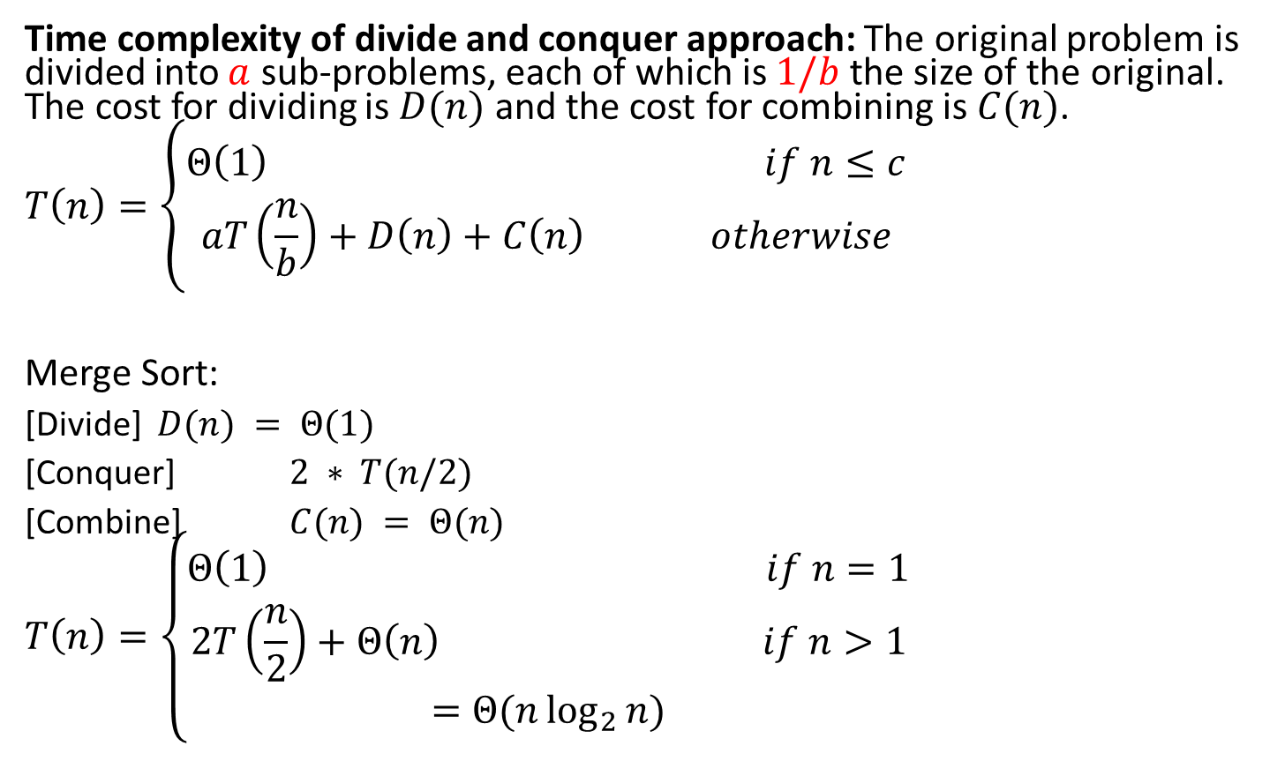
Analysis of Merge Sort
Time complexity of divide and conquer approach: The original problem is divided into $a$ sub-problems, each of which is $1/b$ the size of the original. The cost for dividing is $D(n)$ and the cost for combining is $C(n)$.
$$T\left(n\right)=\left\{\begin{aligned}Θ\left(1\right) if n≤c \\ aT\left(\frac{n}{b}\right)+D\left(n\right)+C\left(n\right) otherwise\end{aligned}\right.$$
Merge Sort:
[Divide] $D(n) = Θ(1)$
[Conquer] $2 ∗ T(n/2)$
[Combine] $C(n) = Θ(n)$
$$T\left(n\right)=\left\{\begin{aligned}Θ\left(1\right) if n=1 \\ 2T\left(\frac{n}{2}\right)+Θ\left(n\right) if n>1 \\ =Θ(n\log_{2}{n})\end{aligned}\right.$$

Slide 44
Analysis of Merge Sort
Statement Cost
So T(n) = Θ(1) when n = 1, and 2T(n/2) + Θ(n) when n > 1
MergeSort (A, p, r) T(n)
if p < r Θ(1)
then q ← ⎣(p+r)/2⎦ Θ(1)
MergeSort (A, p, q) T(n/2)
MergeSort (A, q+1, r) T(n/2)
Merge (A, p, q, r) Θ(n)

Slide 45
Recurrence Relations
Equation or an inequality that characterizes a function by its values on smaller inputs.
Recurrence relations arise when we analyze the running time of iterative or recursive algorithms.
Ex: Divide and Conquer.
T(n) = Θ(1) if n ≤ c
T(n) = a T(n/b) + D(n) + C(n) otherwise
Solution Methods
Substitution Method.
Recursion-tree Method.
Master Method.

Slide 46
Substitution Method
Guess the form of the solution, then use mathematical induction to show it correct.
Substitute guessed answer for the function when the inductive hypothesis is applied to smaller values – hence, the name.
Works well when the solution is easy to guess.
No general way to guess the correct solution.
Notes:
Talk about how mathematical induction works.

Slide 47
Example – Exact Function
Recurrence: T(n) = 1 if n = 1
T(n) = 2T(n/2) + n if n > 1
Guess: T(n) = n lg n + n.
Induction:
Basis: n = 1 ⇒ n lgn + n = 1 = T(n).
Hypothesis: T(k) = k lg k + k for all k < n.
Inductive Step: T(n) = 2 T(n/2) + n
= 2 ((n/2)lg(n/2) + (n/2)) + n
= n (lg(n/2)) + 2n
= n lg n – n + 2n
= n lg n + n

Slide 48
Recursion-tree Method
Making a good guess in substitution method is sometimes difficult
Use recursion trees to devise good guesses.
Recursion Trees
Show successive expansions of recurrences using trees.
Keep track of the time spent on the subproblems of a divide and conquer algorithm.
Help organize the algebraic bookkeeping necessary to solve a recurrence.

Slide 49
Recursion Tree – Example
Running time of Merge Sort:
T(n) = Θ(1) if n = 1
T(n) = 2T(n/2) + Θ(n) if n > 1
Rewrite the recurrence as
T(n) = c if n = 1
T(n) = 2T(n/2) + cn if n > 1
c > 0: Running time for the base case and
time per array element for the divide and
combine steps.

Slide 50
Recursion Tree for Merge Sort
For the original problem, we have a cost of cn, plus two subproblems each of size (n/2) and running time T(n/2).
Each of the size n/2 problems has a cost of cn/2 plus two subproblems, each costing T(n/4).
cn
cn
Cost of divide and merge.
cn/2
cn/2
T(n/2)
T(n/2)
T(n/4)
T(n/4)
T(n/4)
T(n/4)
Cost of sorting subproblems.

Slide 51
Recursion Tree for Merge Sort
Continue expanding until the problem size reduces to 1.
cn
cn
cn/2
cn/2
cn
lg n
cn/4
cn/4
cn/4
cn/4
cn
c
c
c
c
c
c
cn
Total : cnlgn+cn

Slide 52
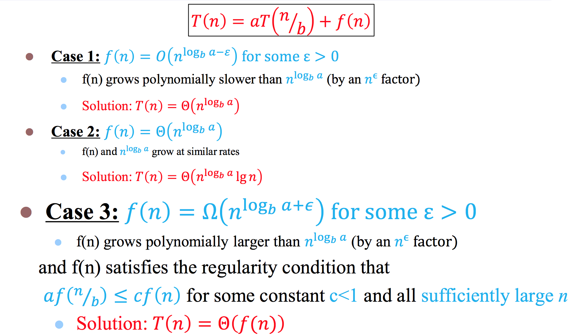
Master Theorem

